Slide 1
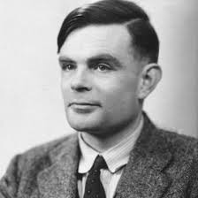
Turing Machines

Slide 2
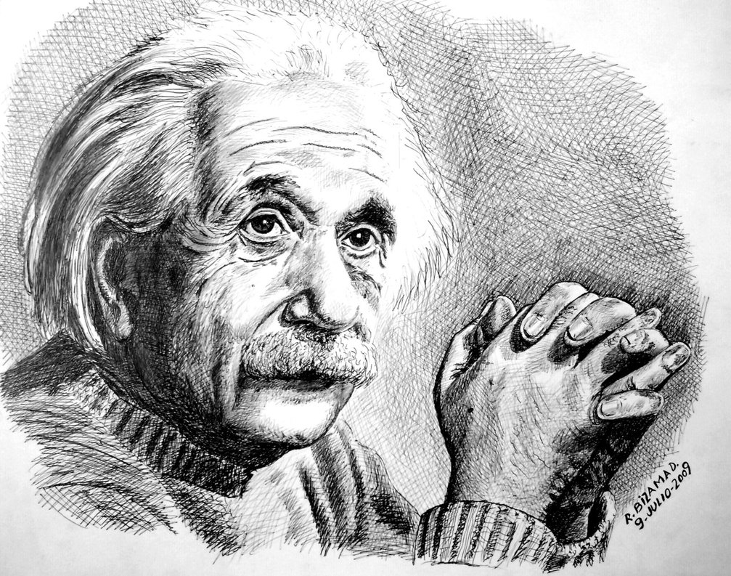
“Everything should be made as simple as possible, but not simpler” – Albert Einstein

Slide 3
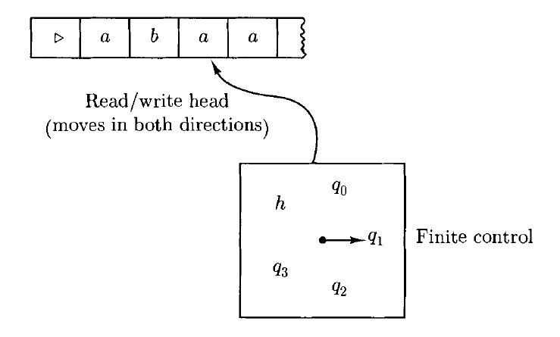
Introduction – Turing Machines
Inventor - Alan Turing (1912-1954)

Slide 4
Turing Machine
Finite State Control Unit, at each step, performs the following two things
Put the control unit in a new state.
Either:
Write a symbol in the tape square currently scanned, replacing the one already there;
or
Move the read/write head one tape square to the left or right.

Slide 5
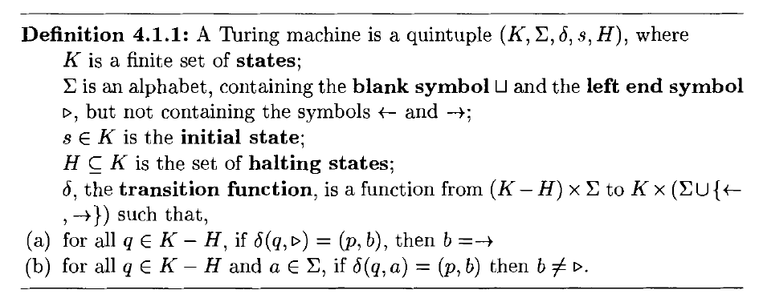
Definition of Turing Machine

Slide 6
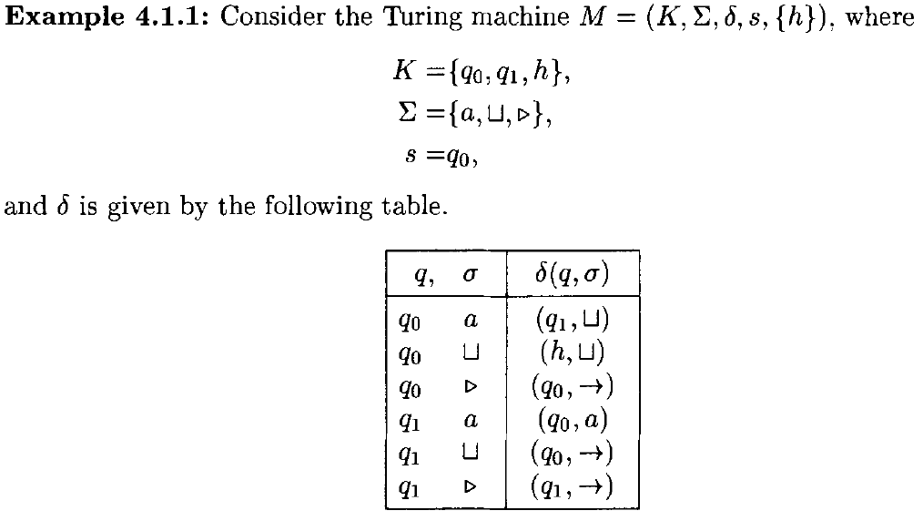

Slide 7

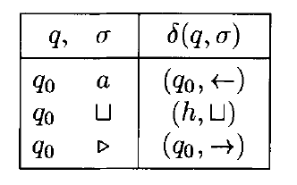

Slide 8


Configuration of a Turing Machine

Slide 9
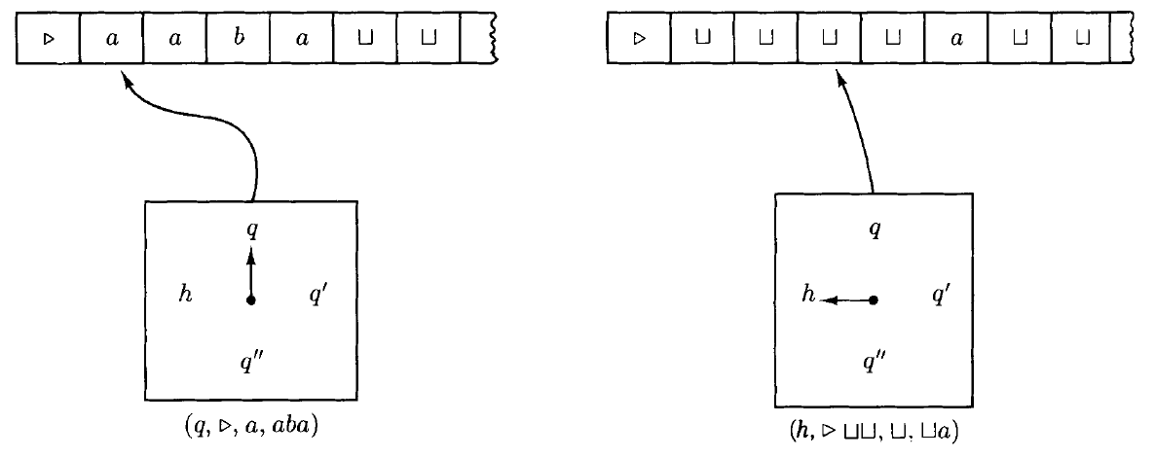


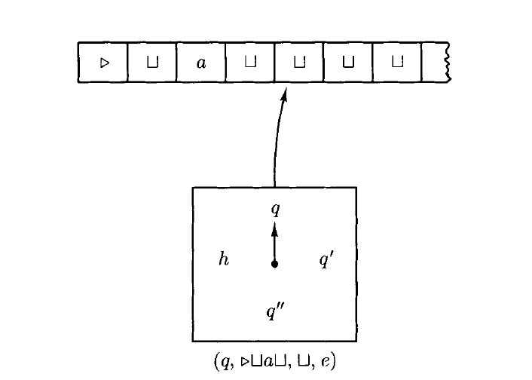


Configurations

Slide 10

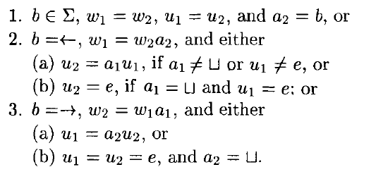


Slide 11
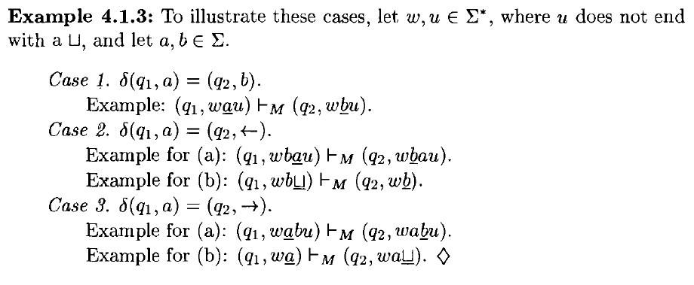

Slide 12

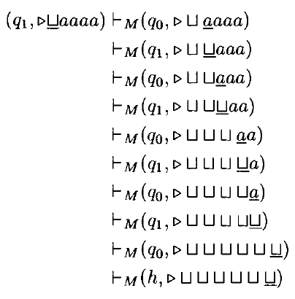
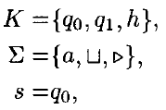
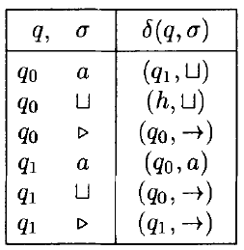

Slide 13


Notation for Turing Machines

Slide 14
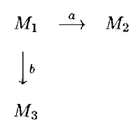


The Rules for Combining Turing Machines

Slide 15
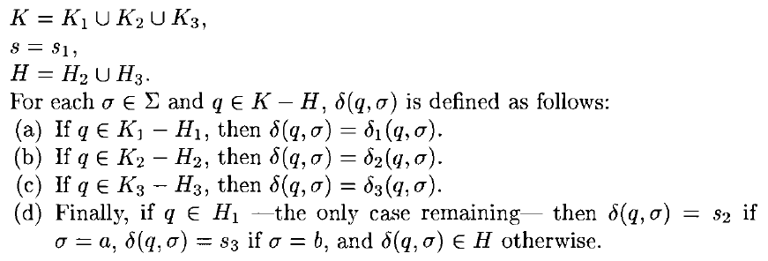
The Rules for Combining Turing Machines

Slide 16
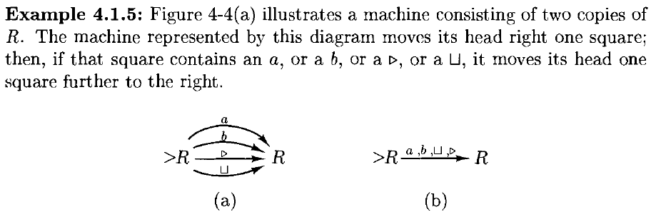



Slide 17
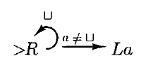
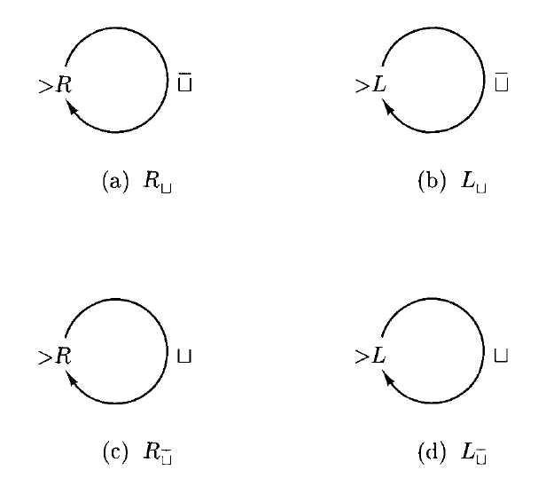

Slide 18
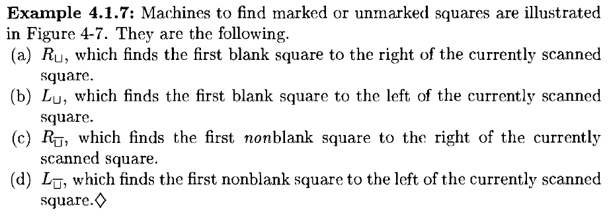



Slide 19
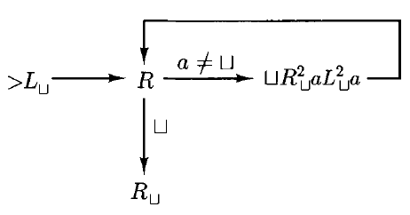
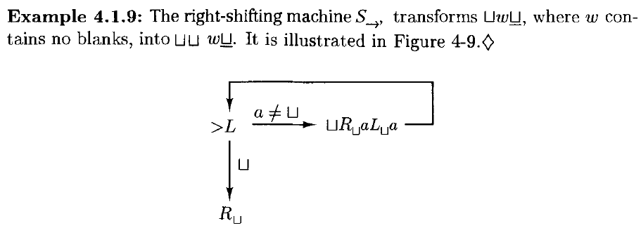

Slide 20


